Slide 1

SC1015 Mini Project
DSF1 Group 6
Lee Ee Cheer
Lim Chien Her
Neo Sun Wen

Slide 2
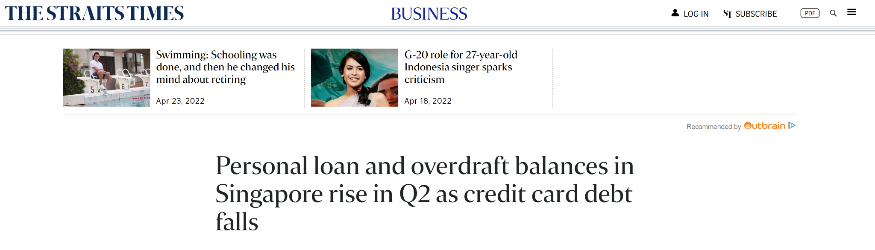
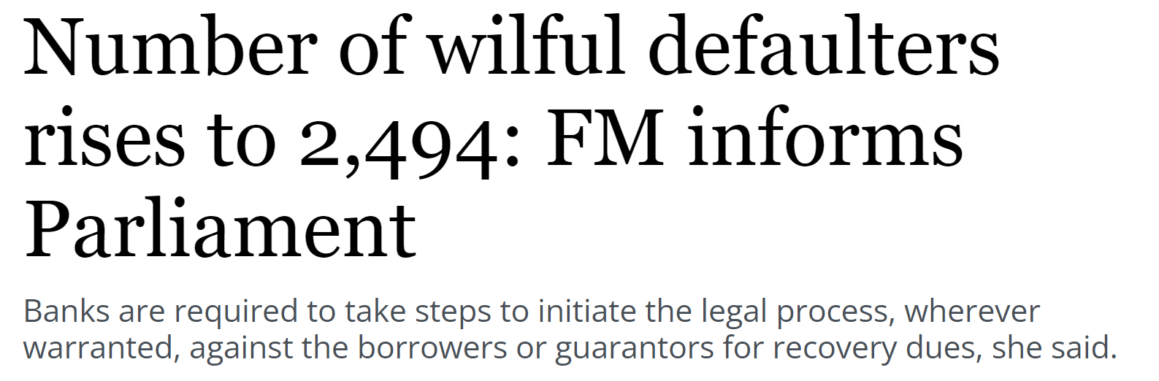
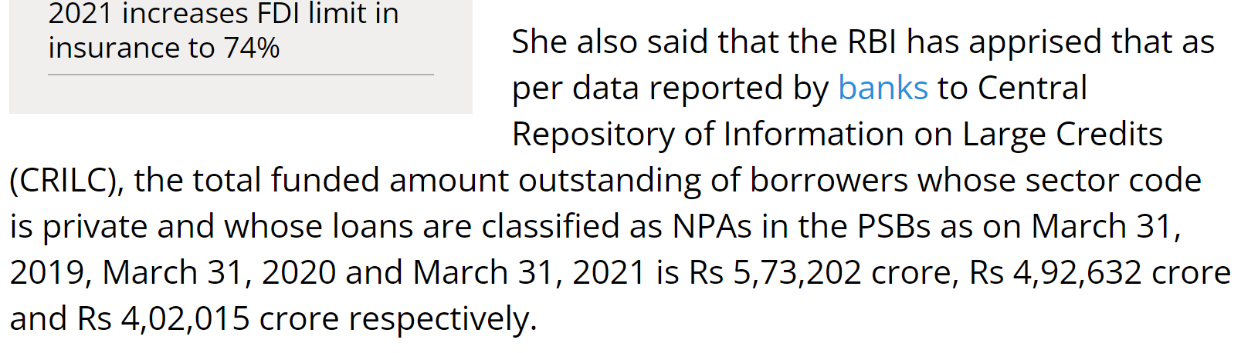

Slide 3
Introduction
Motivation
Help banks predict which clients are more likely to default a loan
Real Life Problem
India faces huge losses in loan defaults every year
Problem Statement
Given the profile of an individual, how can we use these variables to predict the probability of him/her defaulting on a loan that is about to be taken?

Slide 4
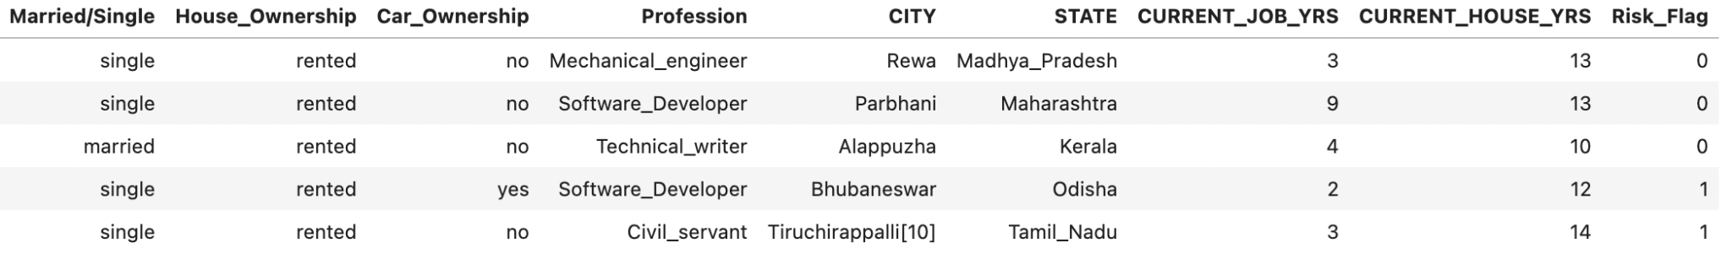
Dataset

Slide 5
Our Journey
Understand
Explore
Engage
Discover
We learnt about the different variables in the dataset.
Through EDA, we explore deeper into each variable and discover valuable insights
Using machine learning, we further explore the variables and come out with a model
Shortlisting the important variables, we consolidate our findings.

Slide 6
Exploratory
Data
Analysis
Understand
Explore
Engage
Discover

Slide 7
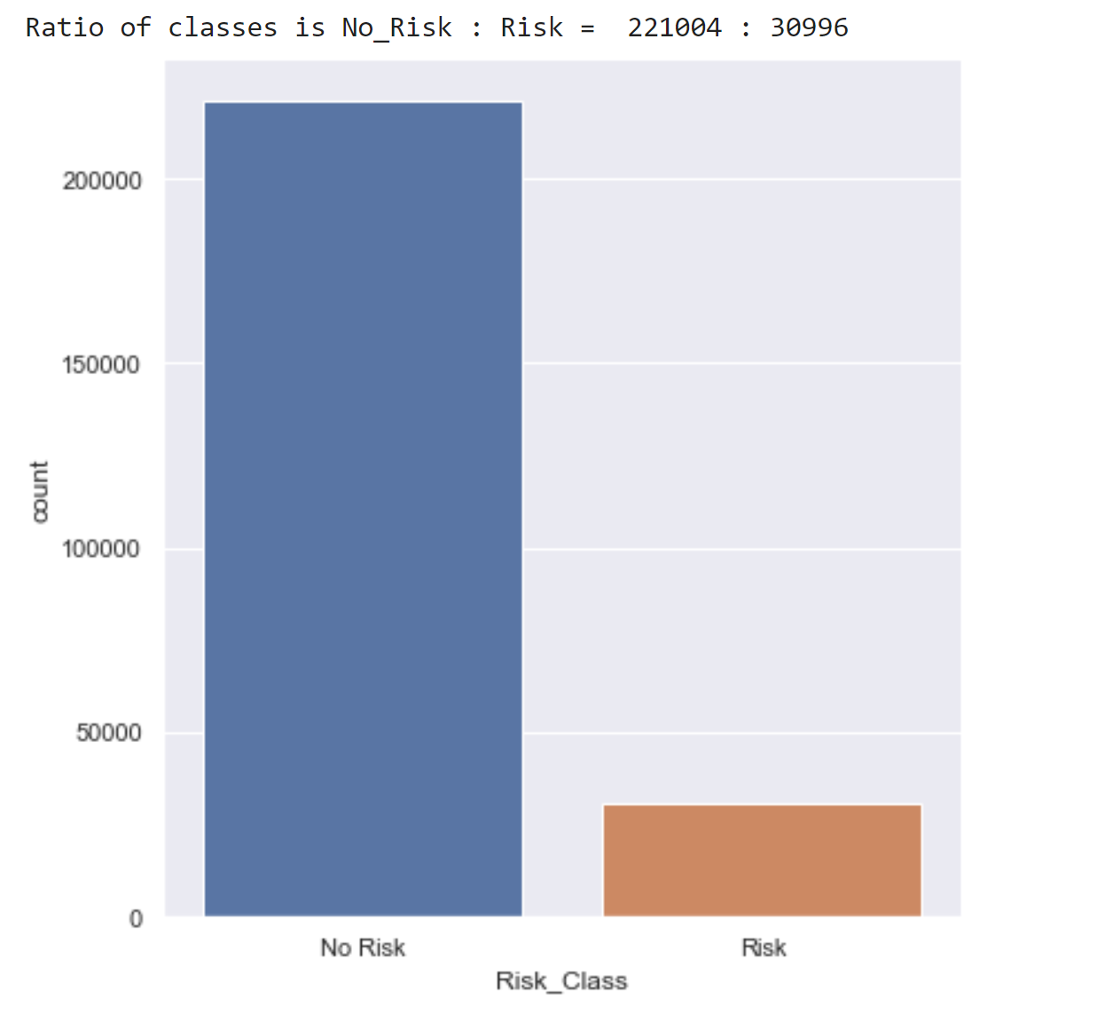
Univariate Analysis on Risk_Class
Disproportionately more No Risk than Risk
87.7%
12.3%

Slide 8
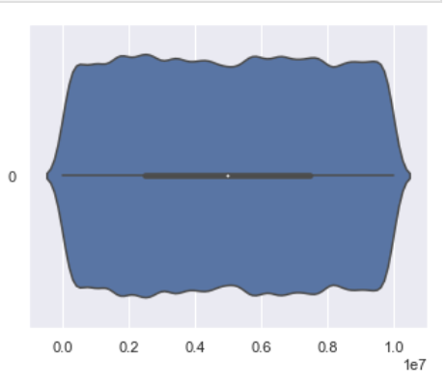
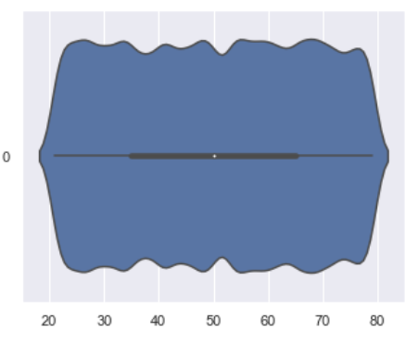
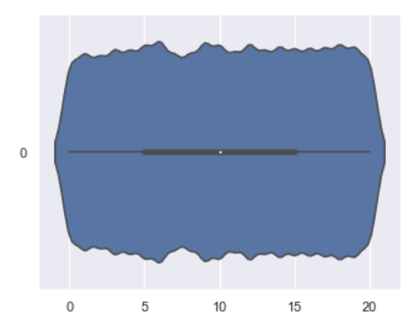
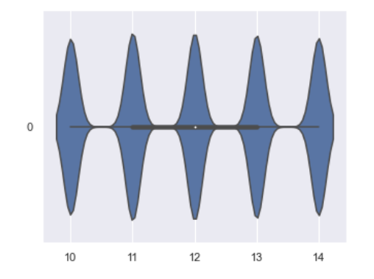
Univariate Analysis on Numeric Variables
Even distribution throughout the range
Income
Age
Experience
CURRENT_HOUSE_YRS

Slide 9
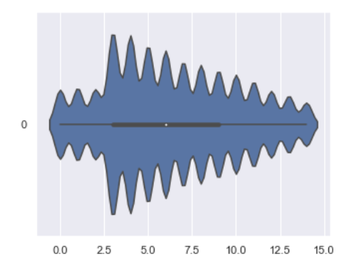
Univariate Analysis on Numeric Variables
Uneven distribution throughout the range only for CURRENT_JOB_YRS
CURRENT_JOB_YRS

Slide 10
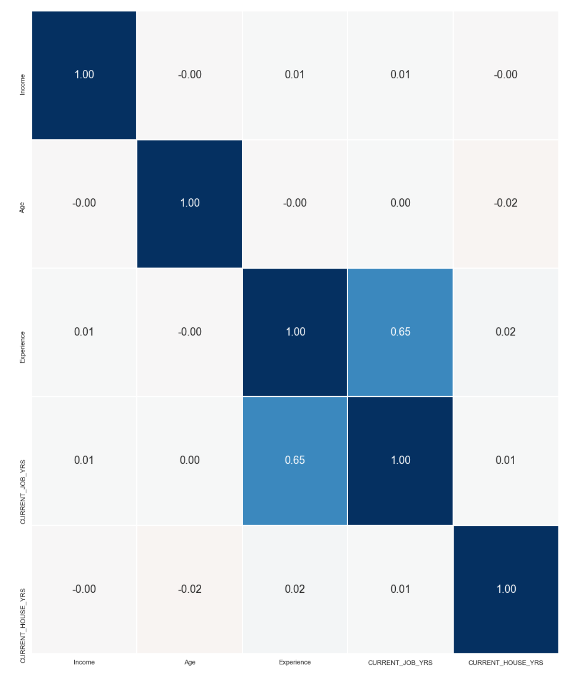
Bivariate Analysis on Numeric Variables
CURRENT_JOB_YRS & Experience
Correlation of 0.65
No correlation between other pairs of numeric variables

Slide 11
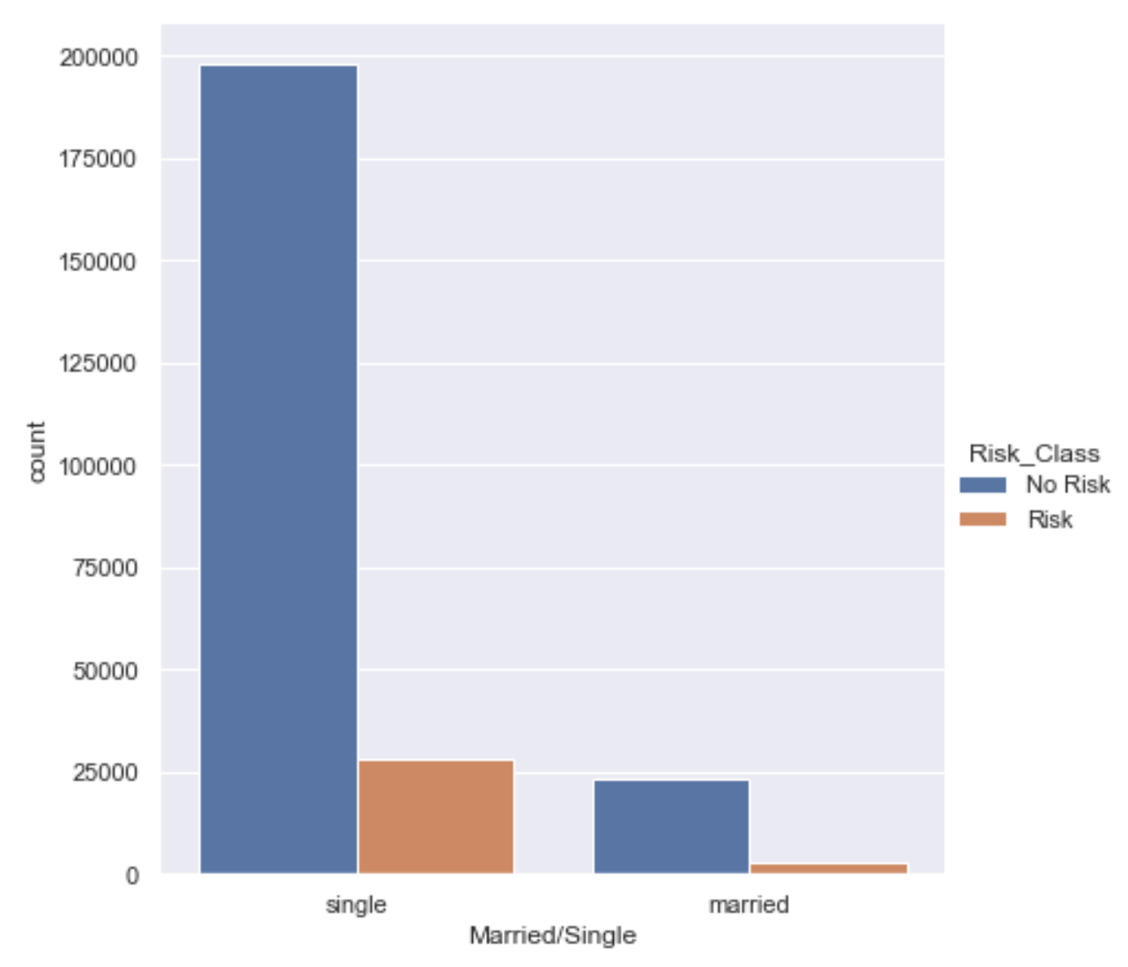
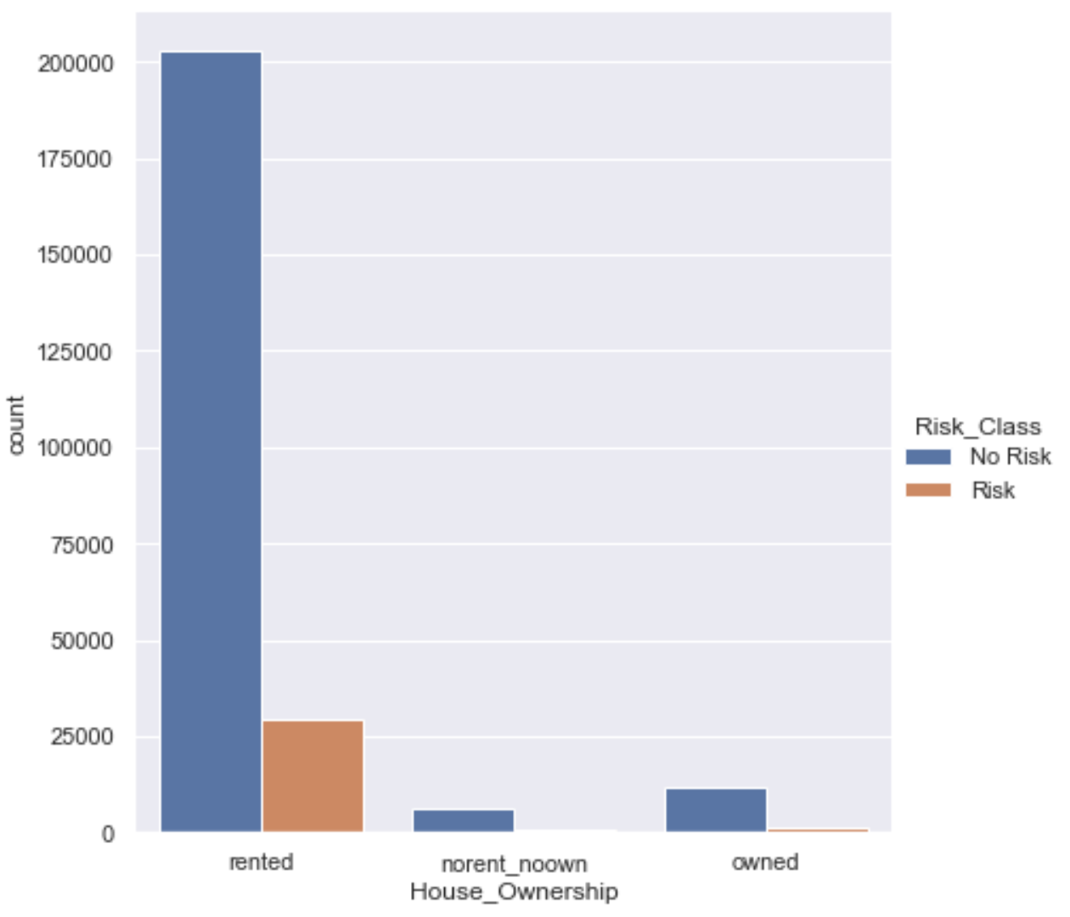
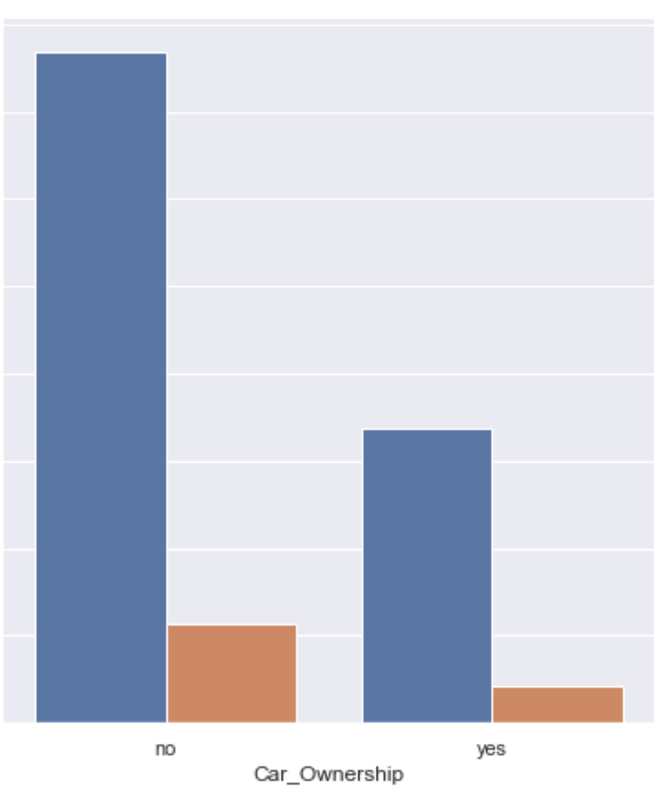
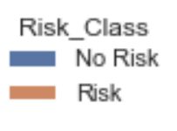
Categorical VS Risk_Class Analysis
Married/Single
House_Ownership
Jupiter
Most of the individuals who carry a risk has rented their houses

Slide 12
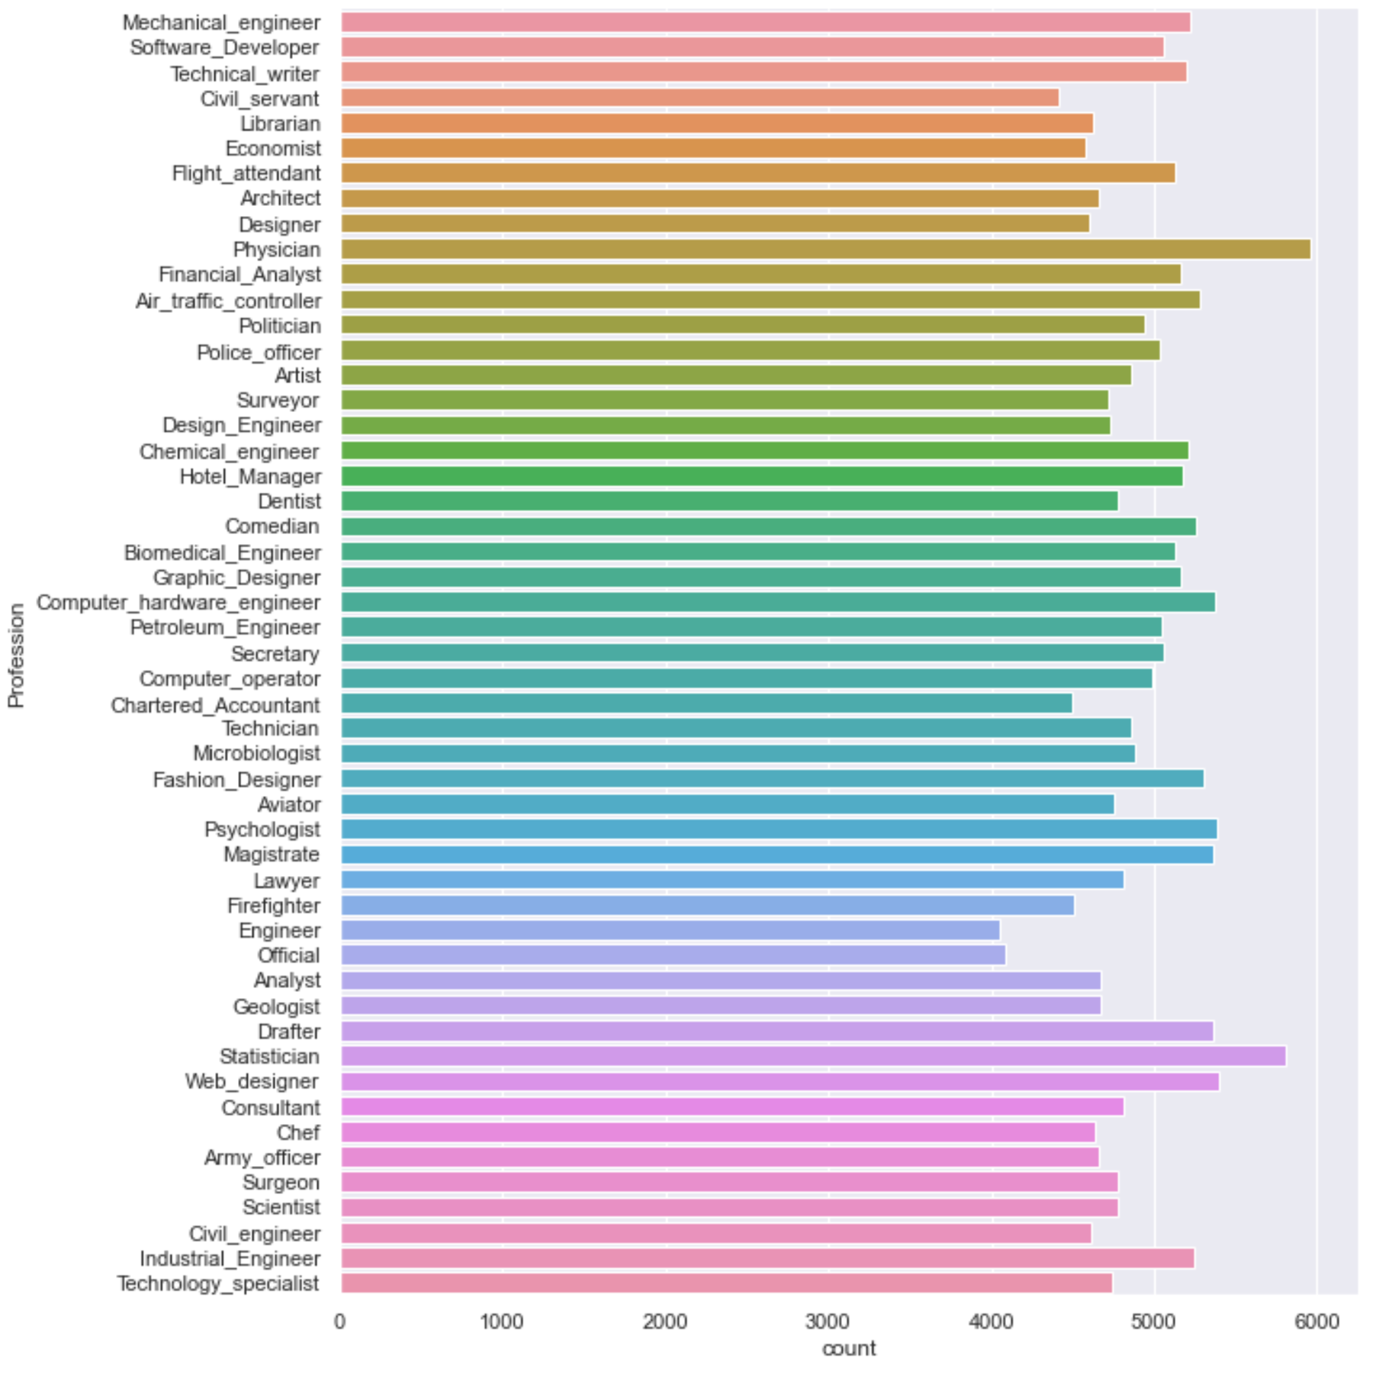
Categorical VS Risk_Class Analysis
Physician
Highest Frequency
Police_officer
Highest Rate
Firefighter
Technology_specialist
Lowest Frequency
Lowest Rate

Slide 13
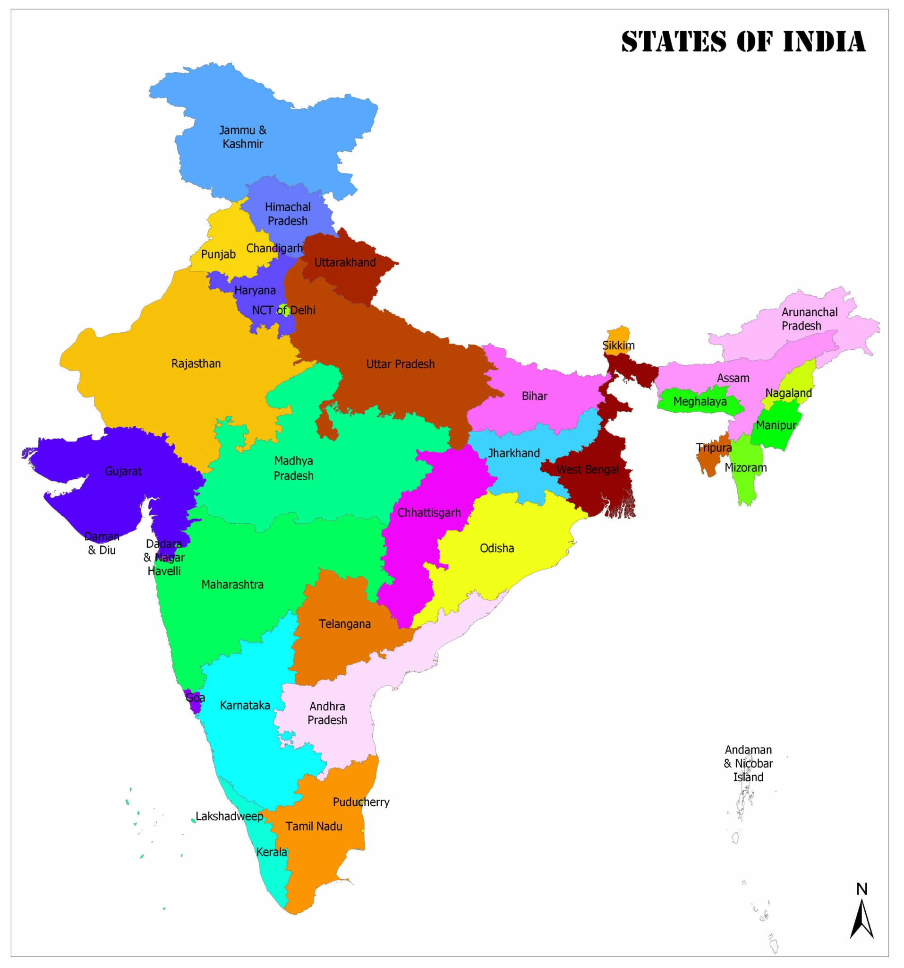
Categorical VS Risk_Class Analysis
Manipur
21.55% with Risk
BEST AND WORST CITIES
Highest Risk Rate
Low Frequency
Bhubaneswar : 32.62%
Gandhinagar : 2.61%
Sikkim
4.61% with Risk
Lowest Risk Rate
Lowest Frequency

Slide 14
Machine Learning
Understand
Explore
Engage
Discover

Slide 15
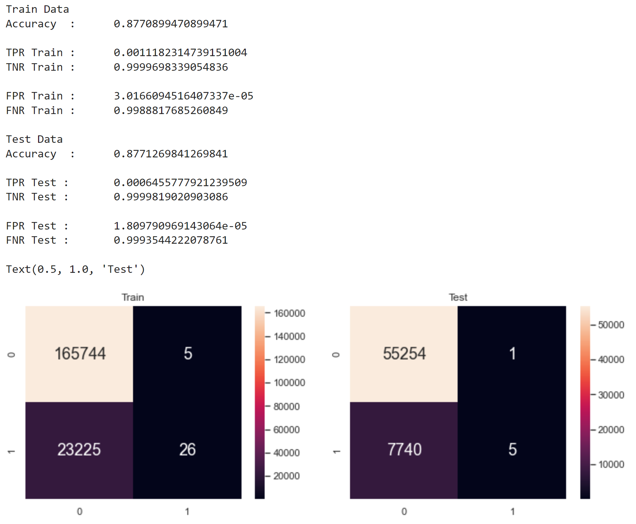
Multivariate Classification Tree (Non-Upsampled)
Accuracy: 0.88

Slide 16
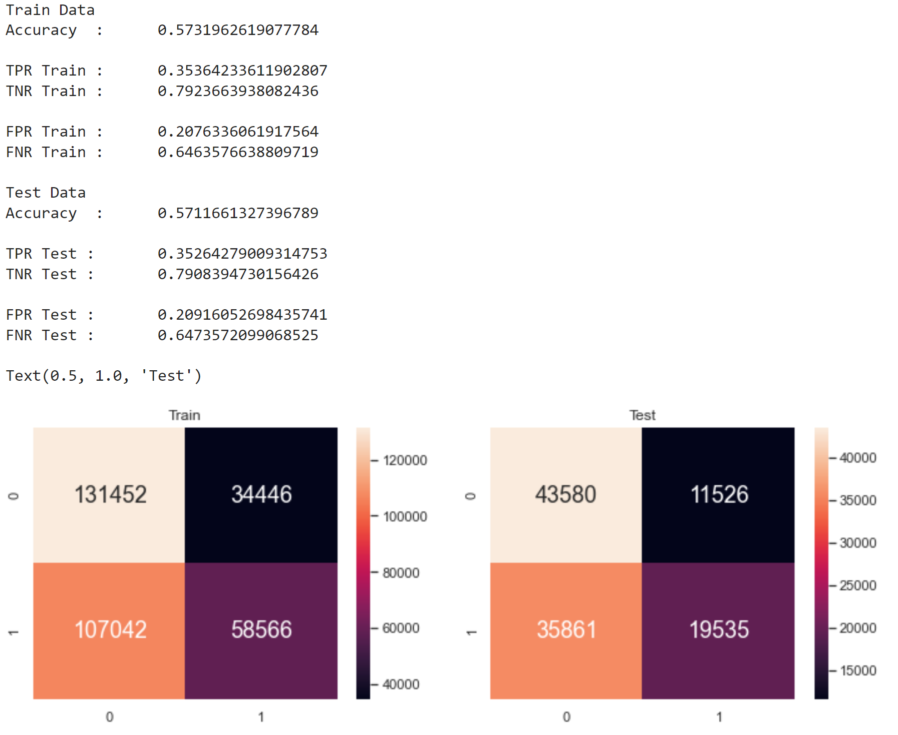
Multivariate Classification Tree (Upsampled)
Accuracy: 0.57
From the classification tree, age is the best determinant

Slide 17
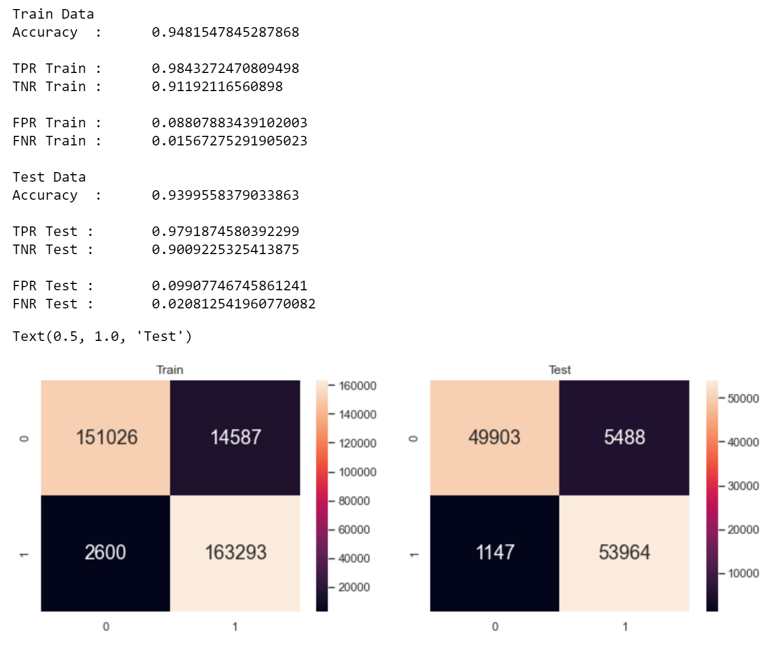
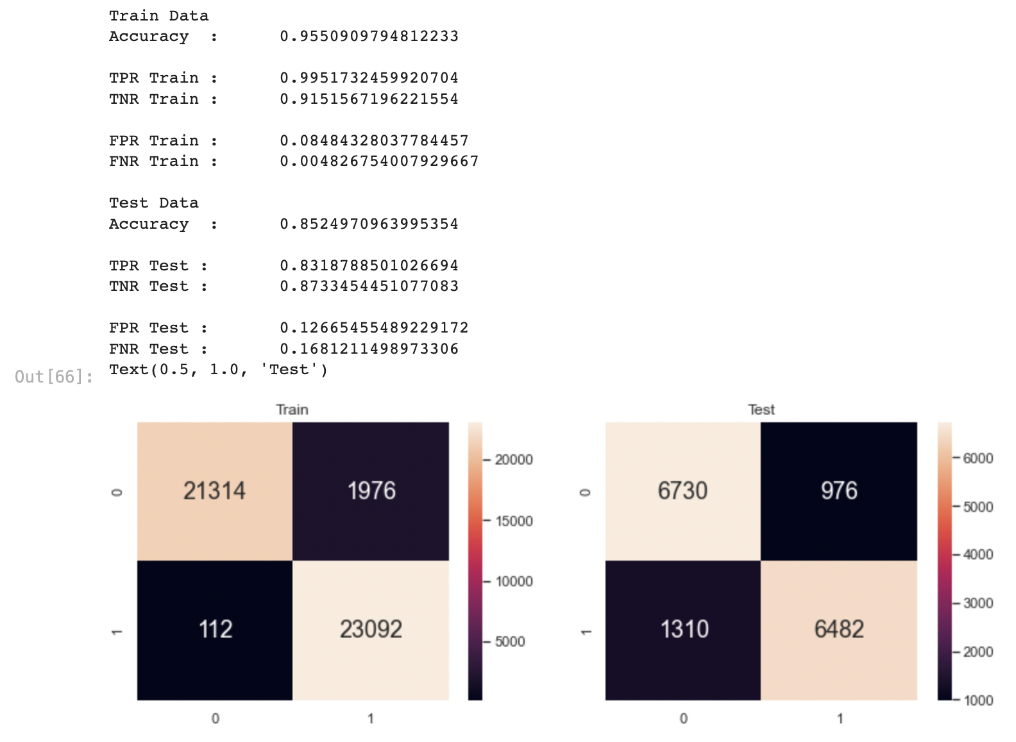
Random Forest Upsampled vs Downsampled
FNR: 0.02
FNR: 0.17
Testing on duplicated data vs actual data in the dataset

Slide 18
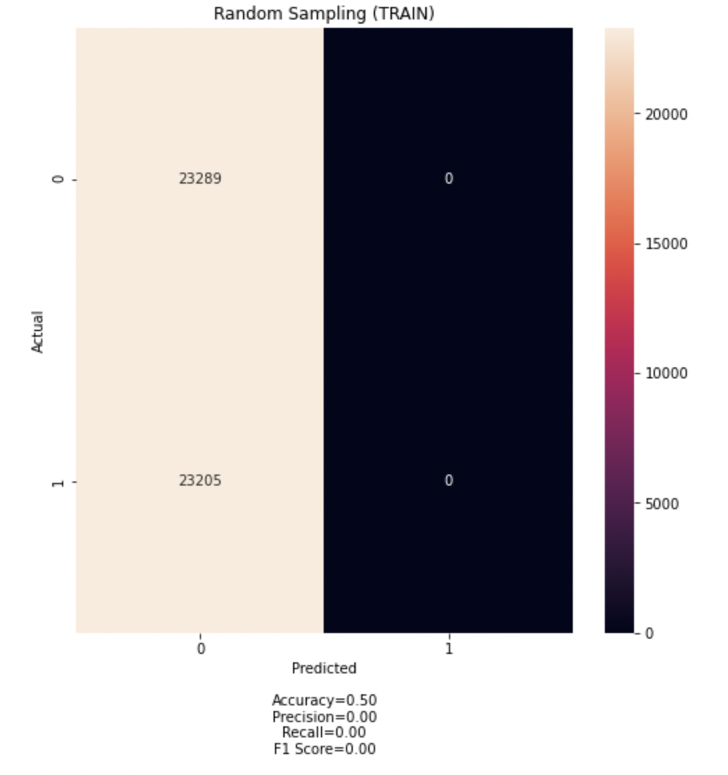
Logistic Regression

Slide 19
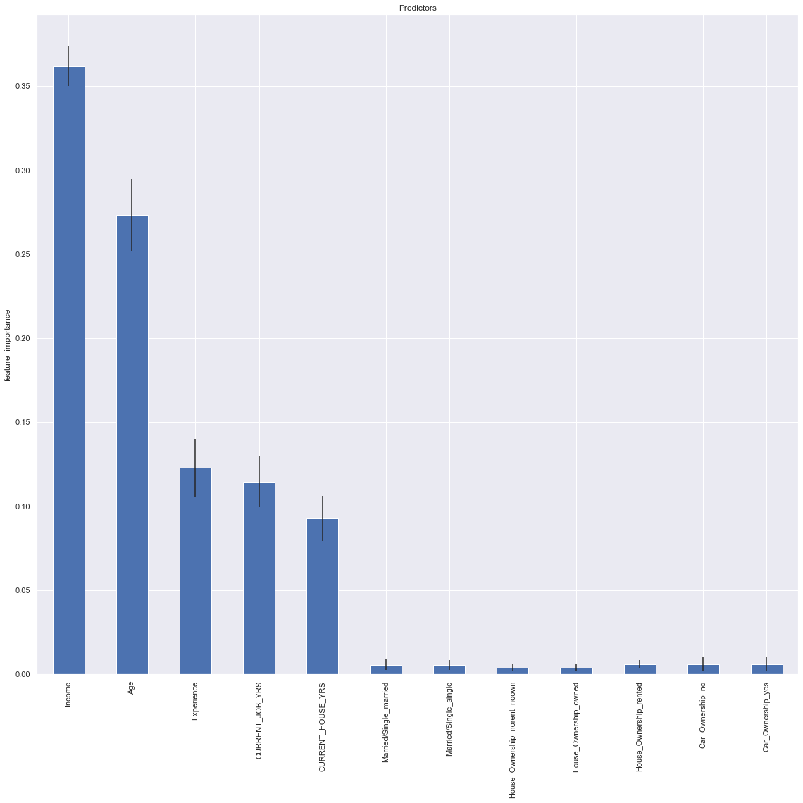
Feature Importance

Slide 20
Further Insights
Understand
Explore
Engage
Discover

Slide 21
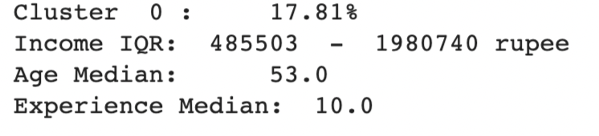
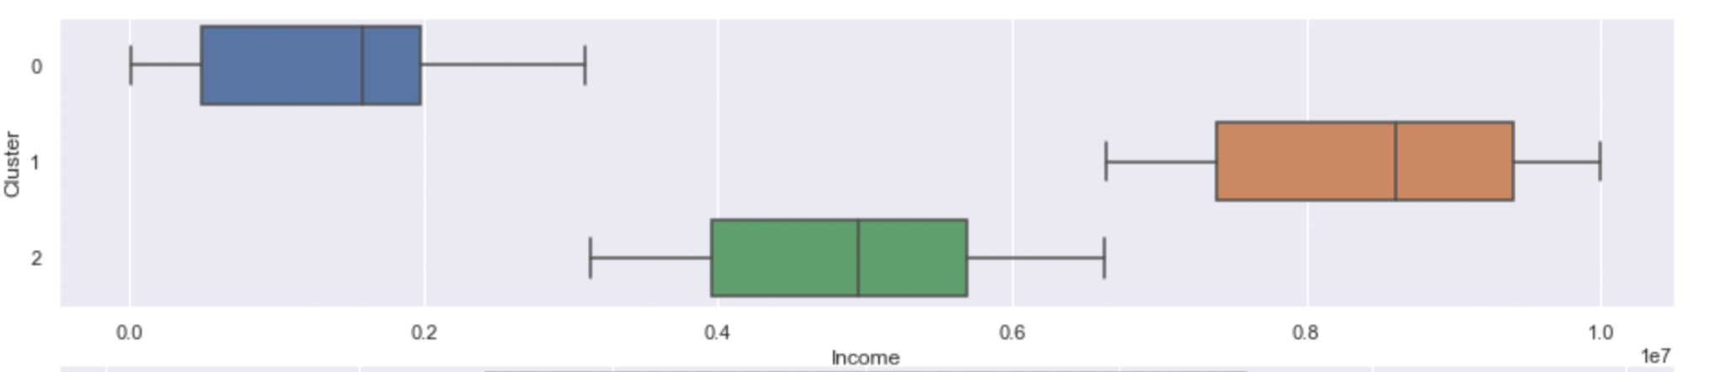
Multi-Variate Clustering: Police Officer

Slide 22
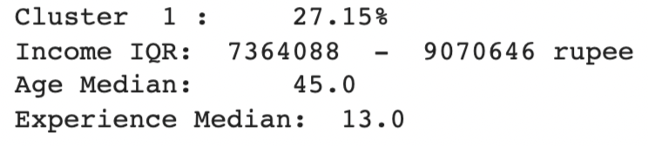
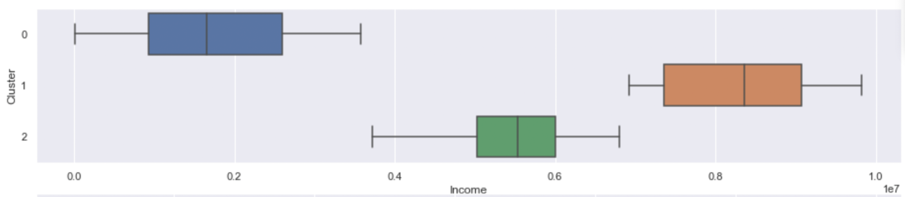
Multi-Variate Clustering: Manipur

Slide 23
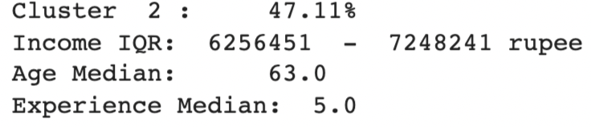
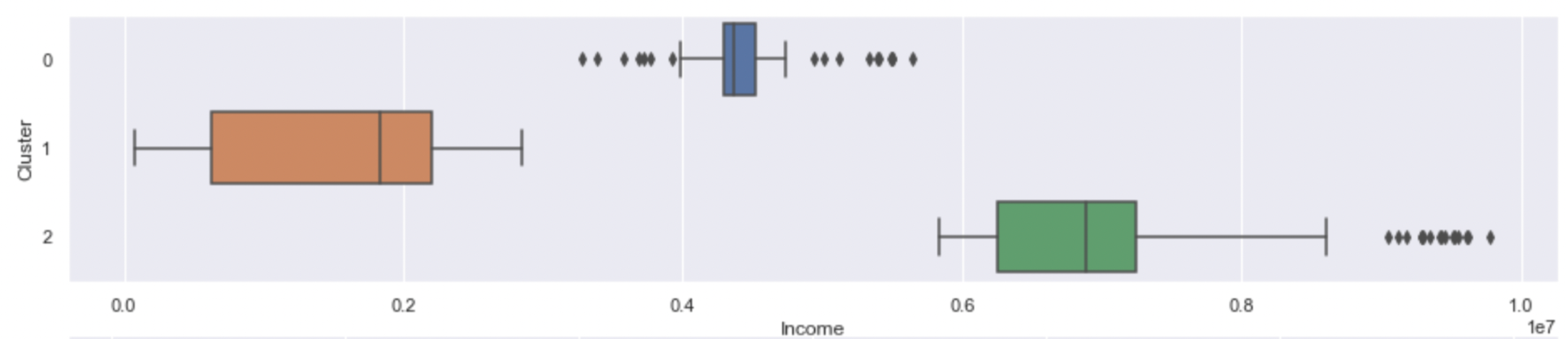
Multi-Variate Clustering: Bhubaneswar

Slide 24
Our takeaways from this project
Finding the most important variable using Feature Importances on the Random Forest model.
Accuracy but also FNR is very high for the classification tree model.
Random Forest produced high accuracy and low FNR.
Working with skew data and its impacts
Disproportionate amount of Risk Flag ‘No’ means that the prediction accuracy will be artificially high unless we balance the data
Upsampling vs Downsampling
Logistic Regression
Working with large data and finding trends
Zooming into particular categorical datas

Slide 25
So, what should banks take note of?
Prioritise income and age
Professions to take note of are police officers and physicians
State to be careful of will be Manipur
City to be careful of will be Bhubaneswar
What specific group should the bank be especially careful of?
People living in Bhubaneswar, having an income of around 6 000 000 to 7 000 000 rupees, around 60 y/o, having 5 years of working experience.
1 in 2 will default!
Notes:
So what should banks take note of?
Our EDA showed that banks should be cautious of individuals who have rented their houses, polices officers, physicians. People living in Manipur or Bhubaneswar have a high chance of defaulting too.
Our machine learning showed that income and age is important too.
So there remains the million dollar question->which specific group should banks be especially careful of?
People living in Bhubaneswar, having an income of around 6 000 000 to 7 000 000 rupees, around 60 y/o, having 5 years of working experience.
1 in 2 will default!

